Slide 1
Social Influence Maximization
Analisys of the IM and OIM problems
Dello Preite Castro Gianmarco - matricola 905131
Paci Marco - matricola 905713
Valladares Stefano - matricola 893624

Slide 2
Outline
Diffusion Model and the Influence Maximization problem.
Policies: greedy and heuristic policies
Online influence Maximization problem
Results

Slide 3
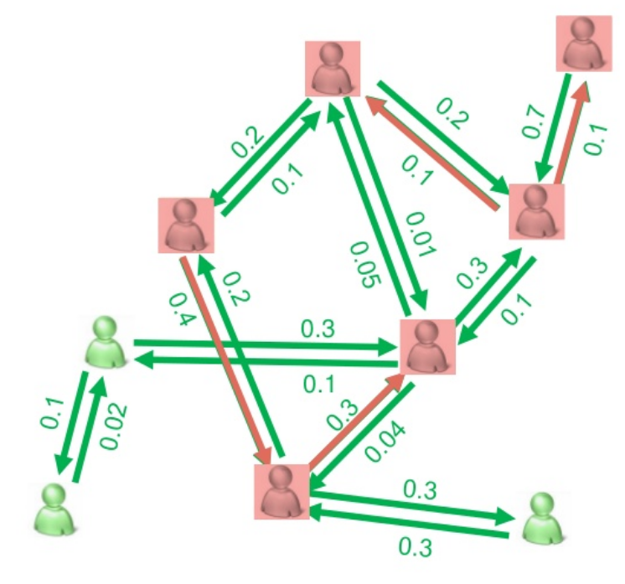
Diffusion Problem
A Social Network can be represented as a Di-graph: G = (V,E)
V: Set of nodes, representing individuals in the Social Network
E: Set of edges, representing directed influence relation
Influence Diffusion Process
The diffusion process in the graph starts from a Seed Set (S), which is a subgroup of the nodes.
Starting from the Seed Nodes, other nodes are activated following a diffusion model ( In our case we used the Independent Cascade model )
The Influence Spread 𝝈(𝑺) is the number of expected influence nodes starting from a seed set S

Slide 4
Independent Cascade Model
Each edge (u,v) as a propagation probability p(u,v). Some seed nodes are initially activated.
At each time step t, each node u activated at time t-1, activates its neighbour v with probability p(u,v)
The process stops when no more nodes are active.

Slide 5
Influence Maximization
Given a social network, a diffusion model (IC) with the parameters, and a budget k, find a seed set S, of at most k nodes, such that the influence spread 𝝈(𝑺) is maximized.
If the nodes have the same cost, k is the maximum number of nodes. If the nodes have different cost associated to each, then k is the maximum sum of the cost of the selected nodes in the seed sets
Influence maximization under IC model is NP-Hard.
we need approximation to solve it.

Slide 6
Submodularity of the problem
This approximation is given by the fact that the function f(), that adds to a seed set another free node of the graph, is submodular, which mean that the marginal gain from adding an element to a set S is at least as high as the marginal gain from adding the same element to a superset of S.
Formally, a submodular function satisfies
f(S ∪ v) − f(S) ≥ f(T ∪ v) − f(T),
for all elements v and all pairs of sets S ⊆ T.
This concept is used in the greedy algorithm as the basic strategy to solve the problem

Slide 7
Live edge and Monte Carlo Simulation
Given a number of repetition R (The precision of the MC simulation), built a random live-edge graph. That is a subgraph of G where each edge is independently selected as live with its propagation probability.
From the live edge, for each node still not in the seed set, calculate the influence spread adding that node to the seed set (in this scenario the influence spread is the number of reachable nodes from S in the live edge graph).
To speed up the computation of the diffusion in the model, it is possible to use MonteCarlo simulation.
Instead of calculating the cascade diffusion for each node, with MonteCarlo simulation, from random taken live-edge graphs, is possible to achieve the same results

Slide 8
Policies
We used different policies to approach the Influence Maximization problem.
The reason behind it is to show how they compare with respect to the Greedy Algorithm, and to see the precision/time tradeoff in the comparison.
The policies to solve the IM problem which we implemented are:
Greedy Algorithm: standard greedy policy. Add to the seed set the node with the highest marginal gain.
CELFpp: Same result as the greedy(in terms of finding the best Seed Set) but faster. It exploit even more the submodularity property of the problem.
DDIC: Degree Discount, heuristic based on the degree of the nodes. Really fast but 15/20% less effective then the formers
SDC: Weak version of DDIC
Random: Select k the nodes randomly

Slide 9
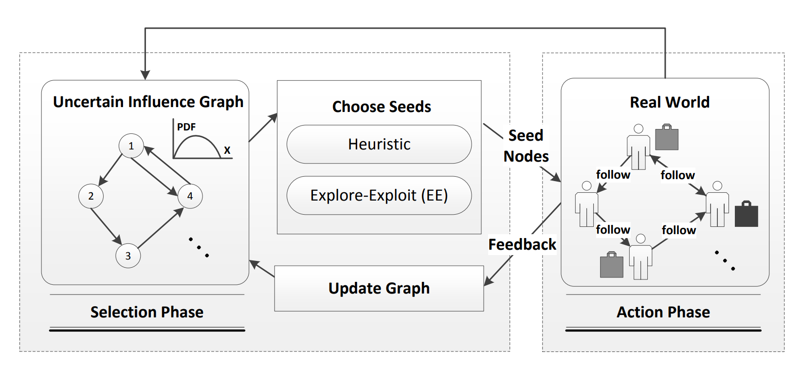
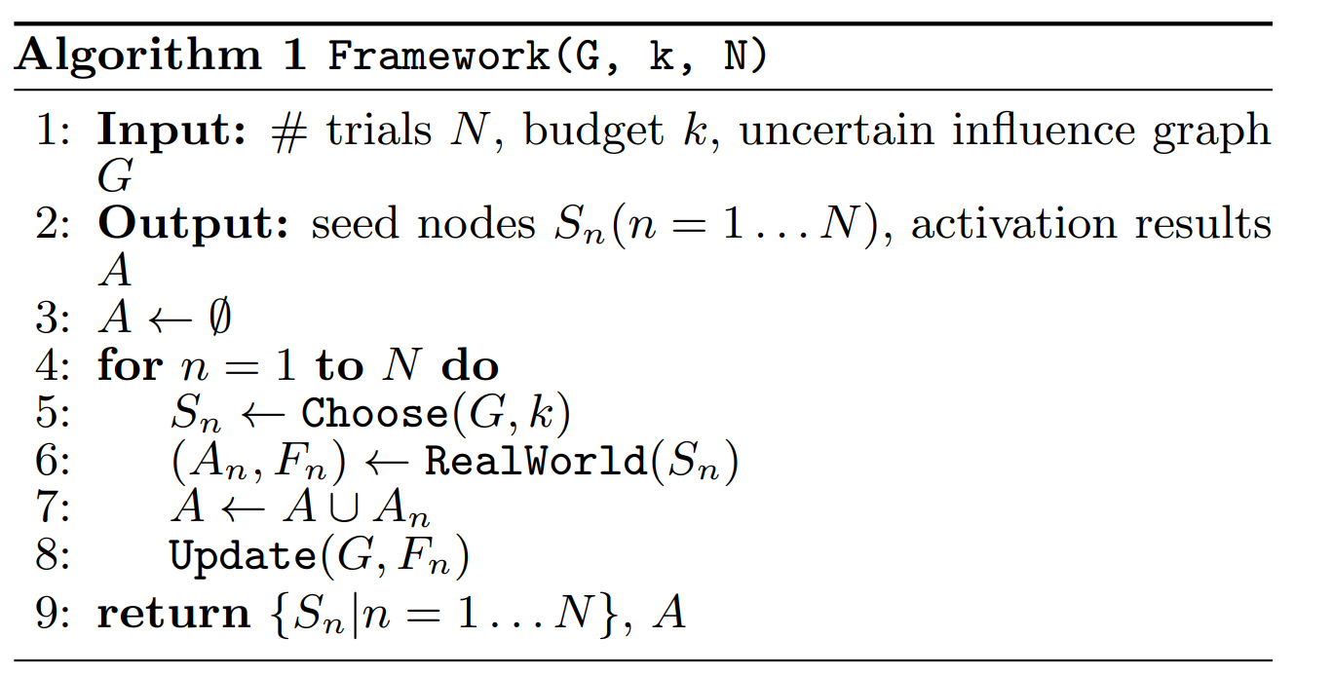
Online Influence Maximization
Problem
This scenario is the most similar to a real world problem. We are given a network, in which we know the edges and the nodes, but we are not given the activation probabilities on those edges.
To solve this scenario, we can use an Explore/Exploit approach (bandit algorithms).
The problem is approached in two ways: - In the first case we try to exploit the linear dependency of the edges with the theta parameters, in a linear regression manner, to learn the theta parameters that are common to all the edges. In this case the feature vector of the edges is known,the algorithm LinearUCB every round learns a better approximation of the theta parameters value and can in this way do a better choice of the seed to select.
In the second case, there is no exploit in the linear dependency of the theta parameters. In this case the Combinatoria UCB and TS algorithms exploit in a standard way the network to select the seed set.

Slide 10
Code Analysis

Slide 11
Graph Creation
The file GraphUtils.py contains all the code aimed to the creation of the graph.
The python library used to create and manage the graph is Networkx.
The function
create_network(n_nodes, n_features, max_degree=None): generate a new oriented network, given the number of nodes and features of the edges.
create_celf_network(n_nodes, n_features, max_degree=None):
Add to the network parameters needed to make the CELFpp algorithms computation easier.
generate_graph_max_neighbors(n_nodes, max_degree):
This function generate a network with a costrain on the max degree of each node.
Also there are function to store and load a network in an external file, in this way the same network can be used over different experiments

Slide 12
Main gredy
MainGredy.py and MainBandit.py are the two main file to run the experiments respectively for the InfluenceMaximization problem and the Online Influence Maximization problem.
We kept a symmetric structure for the two main, changing some parameters to pass in the in the SocialMain function will trigger the execution of one or the other.
main = SocialMain(n_features=4, n_nodes=n_nodes, mc_iterations=[500],budgets=[int(n_nodes * .2) for n_nodes in n_nodes],alg_type='unknown')
Setting the parameters in the SocialMain function will change the problem structure.
The args to pass are the number of feature of the edges (not usefull in this scenario since we are not exploiting that knowledge), the number of nodes of the graph, the montecarlo iteration, the budget a.k.a the max number of nodes in the seed set
The last argument alg_type will start and Online IM if set to ‘unknown’ and an IM one if set to ‘known’
main.run_algs(policies=['lin_ucb', 'cucb', 'cts'],n_experiments=50, time_horizon=200)
Also setting those parameters, the IM algorithm will run on the selected Policies over the same graph, the result will be averaged on the n_experiment and on a selected time_horizon (Only OIM case)

Slide 13
Experiments

Slide 14
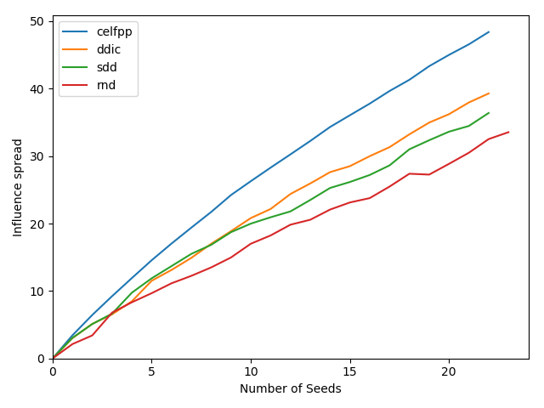
Influence Maximization Problem
The first garph is a sparse network, with low activation probability (around 0.1)
nodes : 150
budget : 22
edges : np.log(nnodes)/nnodes
theta : np.random.dirichlet(np.ones(nf eatures), size = 1)∗np.random.uniform(0, 0.5)
features : np.random.binomial(1, 0.25, size = nf eatures).tolist()
Montecarloiterations : 3000
The running time is also reported to better understand the time complexity issue:
algorithm celfpp running time: 4741s
algorithm ddic running time: 228s
algorithm sdd running time: 227s
algorithm rnd running time: 214s
Note that the heuristics and random algorithms (ddic, sdd, rnd) take all that time because we use MC simulation to plot the influnce spread with every new node in the seed set, otherwise they would run in no time at all

Slide 15
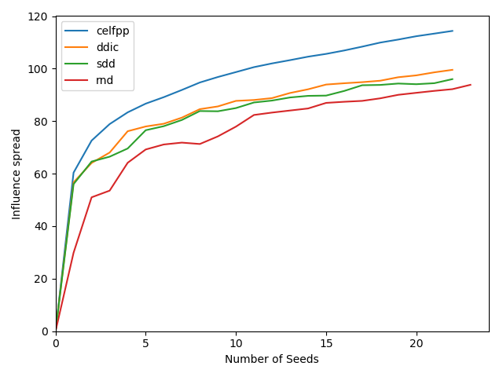
Influence Maximization Problem
The second graph is still a sparse network, but with a higher activation probabilities on the edges
nodes : 150
budget : 22
edges : np.log(nnodes)/n_nodes
theta : np.random.dirichlet(np.ones(nf eatures), size = 1)
features : np.random.binomial(1, 0.25, size = nf eatures).tolist()
Montecarloiterations : 3000

Slide 16
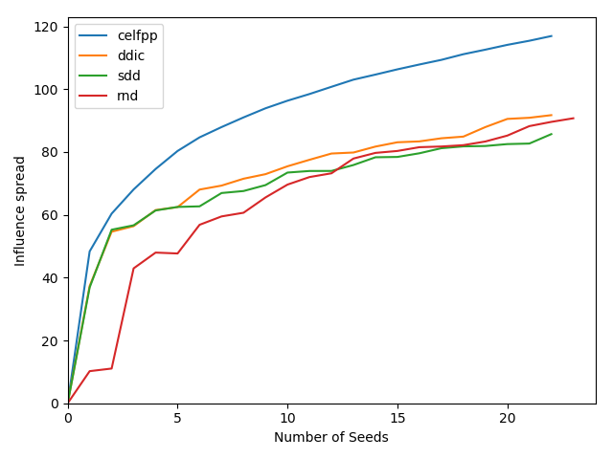
Influence Maximization Problem
The third graph is still a sparse network, same as experiment 2, but with a few really strong edges
Nodes : 150
Budget : 22
edges : np.log(nnodes)/nnodes
theta : np.random.dirichlet(np.ones(n_features), size = 1)
Montecarloiterations : 3000

Slide 17
Online Influence Maximization Problem
For this section we do not have many experimental results. The complexity of the algorithms is too high for a common computer to run in an acceptable time (It is the same as the IM algorithms, multiplied by the number of experiments, the time horizon, the number of algorithms to run, and the complexity to run the simulation of the activation cascade). Every run in this scenario is mediated on a number of experiments, due to the volatility of the data in the real world scenario, given by the activation cascade.

Slide 18
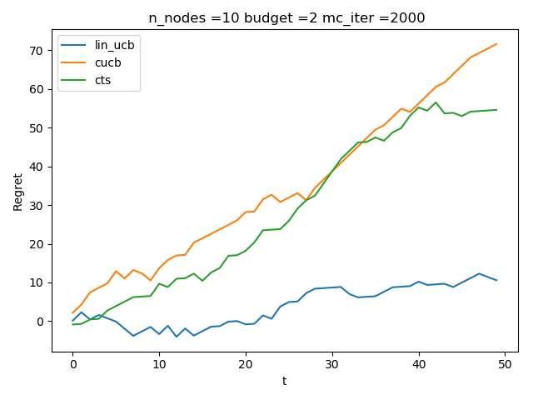
Online Influence Maximization Problem
In this example, the parameters are:
nodes : 10
budget : 2
timehorizon : 50
montecarlosimulatin : 2000
experiment : 20
edges : np.log(nnodes)/nnodes
theta : np.random.dirichlet(np.ones(nf eatures), size = 1)

Slide 19
Conclusion
We carried out all the possible experiments within the limitation of computational power. If the power had been 100 times as much, then we could have exploited more complex graphs.
The given experimental request proved to be out of handle since it's impossible to run such experiments on 10^4 nodes. This became even more evident in the OIM scenario.
For this reason, the code was tested and experimented with a reasonable number of nodes, and not the setup requested by the project assignment.

